Slide 1
Community Cookbooks
Find, Explore and View Chef Cookbooks

Slide 2
Objectives
After completing this module, you should be able to
Find or create a cookbook to manage a proxy server
Configure the proxy server
Upload a cookbook to Chef Server
Bootstrap a new node that runs the proxy server cookbook

Slide 3


Proxy Server
Adding a proxy will allow us to better grow our infrastructure.
Receives requests and relays them to other systems.
Web Server
Proxy Server
Web Server
Notes:
With a single web server running with our organization, it's now time to talk about the next goal to tackle. We need to setup a proxy server.
A proxy server is able to receive requests and relay them to other systems. In our case, we specifically want to use the proxy server to balance the entire traffic load between one or more systems.
This means we will need to establish a new node within our organization, install the necessary software to make the node a proxy server, and configure it so that it will relay requests to our existing node running apache and to future nodes.

Slide 4
Proxy Server
Work that needs to be accomplished to setup a proxy server within our infrastructure:
Write a proxy server cookbook.
We will need to establish a new node within our organization that applies that cookbook.
Proxy Server Cookbook
Node to become Proxy Server
Chef Server
Notes:
Similar to how we installed and configured apache on our first node, we could do the same thing here with a proxy server. We could learn the package name for the application 'haproxy', learn which file manages the configuration, learn how to compose the configuration with custom values, and then manage the service.
Package, Template and Service are the core of configuration management. Nearly all the recipes you write for an application will center on using these three resources. We could spend some time focused on composing the cookbook recipe and testing it on our platform with our custom configuration.

Slide 5
Community Cookbooks
Someone already wrote that cookbook?
Available through the community site called Supermarket/
https://supermarket.chef.io/
Notes:
But what if we told you someone already wrote that cookbook?
Someone already has and that cookbook is available through the community site called Supermarket. Supermarket is a public repository of all the cookbooks shared by other developers, teams, and companies who want to share their knowledge and hard work with you to save you time.

Slide 6
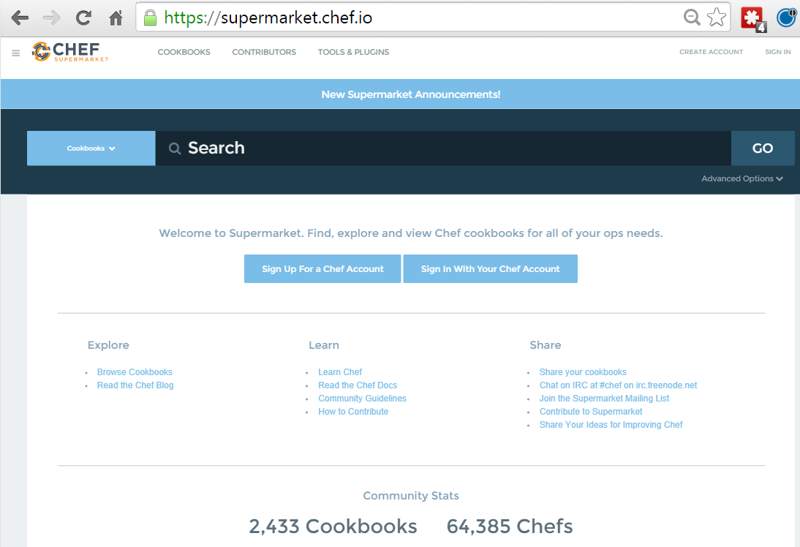
Community Cookbooks
Community cookbooks are managed by individuals.
Chef does not verify or approve cookbooks in the Supermarket.
Cookbooks may not work for various reasons.
Still, there are real benefits to community cookbooks.
Notes:
An important thing to remember is that on the community site are cookbooks managed by individuals. Chef does not verify or approve the cookbooks found in the Supermarket. These cookbooks solved problems for the original authors and then they decided to share them. This means that the cookbooks you find in the Supermarket may not be built or designed for your platform. It may not take into special consideration your needs and requirements. It may no longer be actively maintained.
One thing that we have found is some cookbooks may not work because they were not updated for the platform you are currently deploying it on or it may deploy an application in a way that is counter to requirements defined by your team or organization. Even if the cookbook does not work as a whole, there is still value in reading and understand the source code and extracting the pieces you need when creating your own.
With all that said, there is a real benefit to the community site. When you find a cookbook that helps you deliver value quickly, it can be a tremendous boon to your productivity. This is what we are going to take advantage of with the haproxy cookbook.

Slide 7
Proxy Server
Adding a proxy will allow us to better grow our infrastructure.
Find or Create a Cookbook to Manage a Proxy Server
Configure the Proxy Server to send traffic to the new node
Upload cookbook to Chef Server
Bootstrap a new node that runs the Proxy Server cookbook
Notes:
Lets find the haproxy cookbook within the community site to learn more about it.
https://supermarket.chef.io/

Slide 8
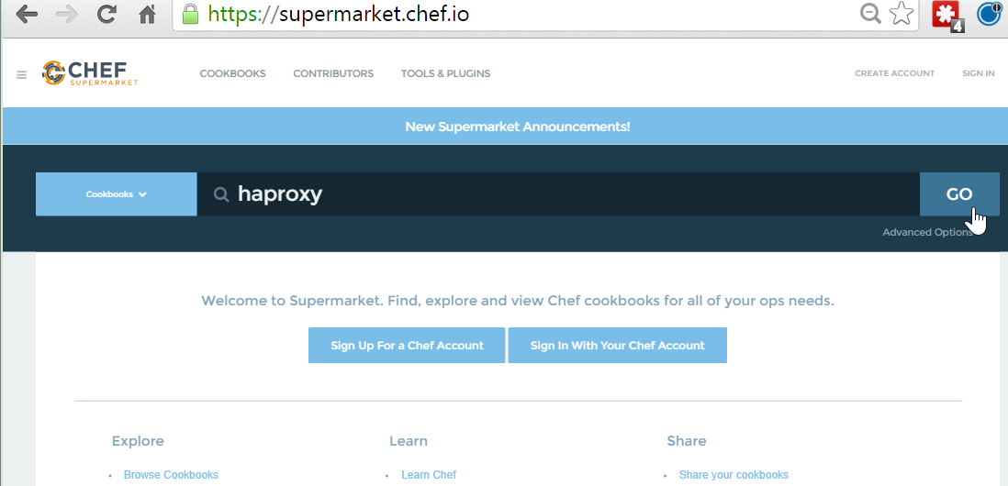
GE: Searching in the Supermarket
From the https://supermarket.chef.io page, type haproxy in the search field and then click the GO button.
Notes:
From the Supermarket main page (https://supermarket.chef.io/) type the search term "haproxy" and the click the GO button.
Below the search term will show us all the matching cookbooks. The haproxy cookbook is in that result set.

Slide 9
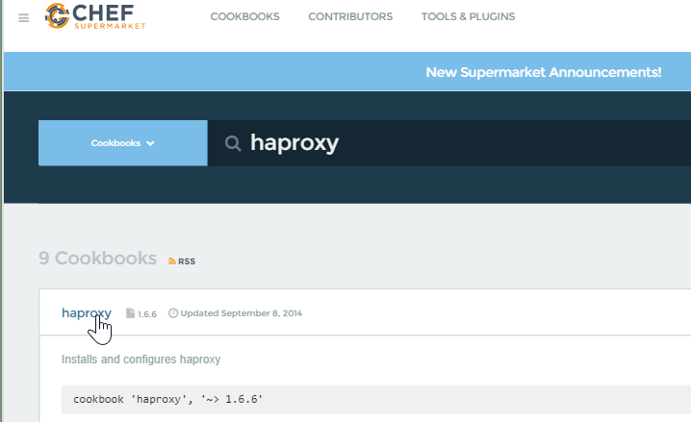
GE: Searching in the Supermarket
Click the resulting haproxy link.
Notes:
Cookbooks usually map one-to-one to a piece of software and usually named after the piece of software that they manage. Select the cookbook named haproxy from the search results.

Slide 10
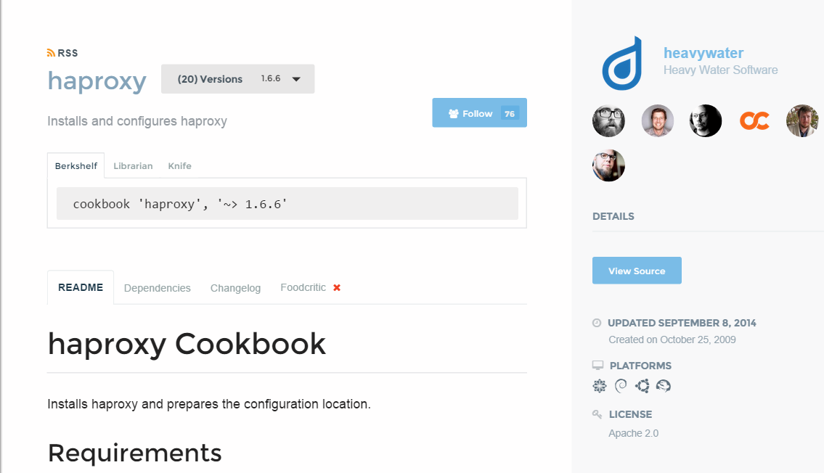
Supermarket Cookbooks
On the right-hand side we can see the individuals that maintain the cookbook...
On the left, we are presented with the various ways we can install the cookbook...
Notes:
At this point you are presented with information that describes the cookbook. Starting on the right-hand side we see the individuals that maintain the cookbook, a link to view the source details, last updated date, supported platforms, licensing, and a link to download the cookbook.
On the left, we are presented with the various ways we can install the cookbook, the README that describes information about the cookbook, any cookbooks that this cookbook may depend on, a history of the changes, and its food critic rating--which is a code evaluator for best practices.

Slide 11
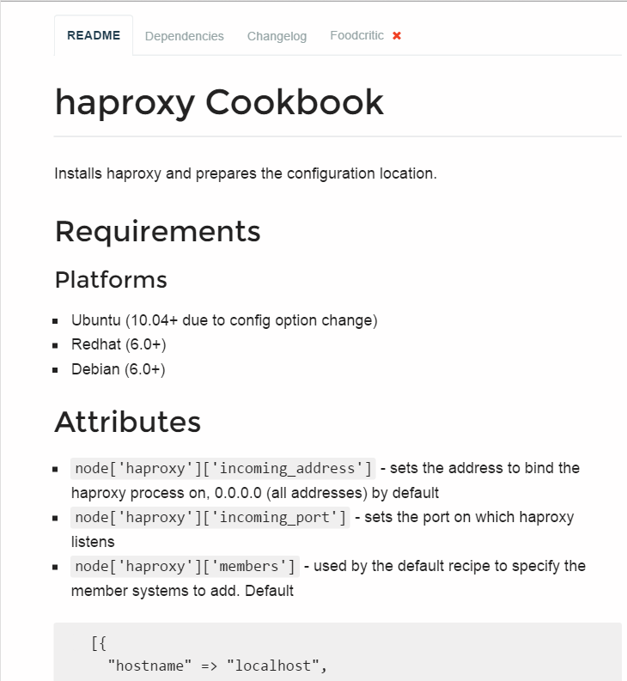
Supermarket Cookbooks
The area to focus most of your attention from the beginning is the README.
Reading and understanding the README at a glance is difficult. It is a skill that comes with time.
Notes:
The area to focus most of your attention from the beginning is the README. The README describes the various attributes that are defined within the cookbook and the purpose of the recipe. This is the same README file found in the cookbooks we currently have within our organization. This one, however, has had far more details added to give new users like us the ability to understand more quickly what the cookbook does and how it does it.
Reading and understanding the README at a glance is difficult. It is a skill that comes with time. For the haproxy cookbook there is an defined attribute that establishes the members that receive the proxy requests from the proxy server. This is available in a node attribute available through `node['haproxy']['members']`.

Slide 12
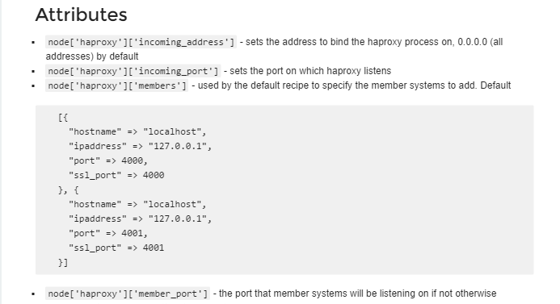
Supermarket Cookbooks
These node attributes are different than the automatic ones defined by Ohai.
Attributes defined in a cookbook are not considered automatic.
https://docs.chef.io/attributes.html
Notes:
Prior to this point we have seen how node attributes are defined by Ohai but cookbooks also have this ability to define node attributes. These node attributes are different than the ones defined by Ohai as well. Ohai attributes are considered automatic attributes and generally inalienable characteristics about the node.
Attributes defined in a cookbook are not considered automatic. They are simply default values that we may change. There are many ways that we provide new default values for these. One way that we will learn is defining a wrapper cookbook.

Slide 13
Supermarket Cookbooks
Wrapper Cookbook
(New additional attributes)
A wrapper cookbook is a new cookbook that encapsulates the functionality of the original cookbook.
It defines new default values for the recipes.
haproxy
Cookbook
(Attributes)
https://docs.chef.io/supermarket.html#wrapper-cookbooks
https://www.chef.io/blog/2013/12/03/doing-wrapper-cookbooks-right/
Notes:
A wrapper cookbook is a new cookbook that encapsulates the functionality of the original cookbook but allows us to define new default values for the recipes.
This is a common method for overriding cookbooks because it allows us to leave the original cookbook untouched. We simply provide new default values that we want and then include the recipes that we want to run.
Lets generate our wrapper cookbook named myhaproxy. Traditionally we would name the cookbook with a prefix of the name of our company and then follow it by the cookbook name 'company-cookbook'.

Slide 14
GE: CD and Generate the Cookbook
$ cd ~/chef-repo
$ chef generate cookbook cookbooks/myhaproxy
Compiling Cookbooks...
Recipe: code_generator::cookbook
* directory[C:/Users/sdelfante/chef-repo/cookbooks/myhaproxy] action create
- create new directory C:/Users/sdelfante/chef-repo/cookbooks/myhaproxy
* template[C:/Users/sdelfante/chef-repo/cookbooks/myhaproxy/metadata.rb] action create_if_missing
- create new file C:/Users/sdelfante/chef-repo/cookbooks/myhaproxy/metadata.rb
- update content in file C:/Users/sdelfante/chef-repo/cookbooks/myhaproxy/metadata.rb from none to 899276
(diff output suppressed by config)
* template[C:/Users/sdelfante/chef-repo/cookbooks/myhaproxy/README.md] action create_if_missing
Notes:
Change to your chef-repo directory and then generate your new cookbook.

Slide 15
GE: Create a Dependency in the Cookbook
~/chef-repo/cookbooks/myhaproxy/metadata.rb
name 'myhaproxy'
maintainer 'The Authors'
maintainer_email 'you@example.com'
license 'all_rights'
description 'Installs/Configures myhaproxy'
long_description 'Installs/Configures myhaproxy'
version '0.1.0'
depends 'haproxy', '~> 1.6.6'
+
Notes:
Set up a dependency within your haproxy cookbook. Establishing this dependency informs the Chef Server that whenever you deliver this cookbook to a node, you should also deliver with it the mentioned dependent cookbooks.
This is important because your cookbook is simply going to set up new default values and then execute the recipes defined in the original cookbook.

Slide 16
Proxy Server
Adding a proxy will allow us to better grow our infrastructure.
Find or Create a Cookbook to Manage a Proxy Server
Configure the Proxy Server to send traffic to the new node
Upload cookbook to Chef Server
Bootstrap a new node that runs the Proxy Server cookbook
Notes:
Now that you have the dependency on the haproxy cookbook in your wrapper cookbook, you need to learn what new default values you need to add to the recipe.

Slide 17
Supermarket Cookbooks
Currently the haproxy cookbook assumes that there are two different services running on the localhost at port 4000 and port 4001.
In a moment, you'll need to change that.
https://docs.chef.io/supermarket.html#wrapper-cookbooks
Notes:
Currently the haproxy cookbook assumes that there are two different services running on the localhost at port 4000 and port 4001. The haproxy process will relay messages to itself to those two ports.
That is not our configuration. First, we currently only have one system that we want to route traffic to. Second, we want to have the traffic routed not to localhost but instead to our webserver, node1, which will have a completely different hostname and IP address.

Slide 18
GE: Capture Node's Public Host Name and IP
$ knife node show --help
knife node show NODE (options)
-a ATTR1 [--attribute ATTR2] , Show one or more attributes
--attribute
-s, --server-url URL Chef Server URL
--chef-zero-host HOST Host to start chef-zero on
--chef-zero-port PORT Port (or port range) to start chef-zero on. Port ranges
-k, --key KEY API Client Key
--[no-]color Use colored output, defaults to false on Windows, true
-c, --config CONFIG The configuration file to use
--defaults Accept default values for all questions
-d, --disable-editing Do not open EDITOR, just accept the data as is
-e, --editor EDITOR Set the editor to use for interactive commands
Notes:
This new default value for the haproxy members needs to define the information about the webserver node, node1. So you need to capture the node's public host name and public IP address.
The 'knife node show' command will display information about the node. You can ask to see a specific attribute on a node with the –a flag or the --attribute flag.

Slide 19
GE: Capture Node's Public Host Name and IP
$ knife node show node1 -a ipaddress
node1:
ipaddress: 172.31.8.68
Notes:
You can display the IP address of node1 with the '-a' flag and specifying the attribute 'ipaddress'.
However, with cloud providers that generate machines for you and assign internal IP addresses, those values may not work properly. So instead, you may need to ask the node for a different set of attributes.

Slide 20
Amazon EC2 Instances
The IP address and host name are unfortunately not how we can address these nodes within our recipes.
Notes:
The reason you may need to ask the node for a different set of attributes is that we are using Amazon as a cloud provider for our instances. These instances are displaying the internal IP address when we ask for the ipaddress attribute.
Ohai collects attributes from the current cloud provider and makes them available in an attribute named 'cloud'. We can look at the cloud attribute on our first node and see that it returns for us information about the node.

Slide 21
GE: Capture Node's Public Host Name and IP
$ knife node show node1 -a cloud
node1:
cloud:
local_hostname: ip-172-31-8-68.ec2.internal
local_ipv4: 172.31.8.68
private_ips: 172.31.8.68
provider: ec2
public_hostname: ec2-54-175-46-24.compute-1.amazonaws.com
public_ips: 54.175.46.24
public_ipv4: 54.175.46.24
Notes:
If you use 'knife node show' to display the 'cloud' attribute for node1, you will see the local, private, and public connection information.
Capture and write down the public hostname and the public ipv4 address of node1. You will need this in the recipe you are going to write.

Slide 22
GE: Edit the myhaproxy/recipes/default.rb
~/chef-repo/cookbooks/myhaproxy/recipes/default.rb
#
# Cookbook Name:: myhaproxy
# Recipe:: default
#
# Copyright (c) 2015 The Authors, All Rights Reserved.
include_recipe "haproxy::default"
Notes:
First, within the myhaproxy cookbook you will use the include_recipe method to specify the fully-qualified name of the cookbook and recipe that you want to execute. In this case, when you run your wrapped cookbooks recipe, you'll want it to run the original cookbook's default recipe.
You could define new recipes from within this cookbook for every recipe that you want to support in your wrapper cookbook. Here we are only interested in the resources configured in the default recipe of the haproxy cookbook.

Slide 23
GE: Edit the myhaproxy/recipes/default.rb
~/chef-repo/cookbooks/myhaproxy/recipes/default.rb
#
# Cookbook Name:: myhaproxy
# Recipe:: default
#
# Copyright (c) 2015 The Authors, All Rights Reserved.
node['haproxy']['members'] = [{
"hostname" => "localhost",
"ipaddress" => "127.0.0.1",
"port" => 4000,
"ssl_port" => 4000
}, {
"hostname" => "localhost",
"ipaddress" => "127.0.0.1",
"port" => 4001,
"ssl_port" => 4001
}]
inlude_recipe "haproxy::default"
Notes:
Without changing anything any further, using this cookbook will simply execute the original cookbooks' recipe with all the same default values. Before you execute that recipe, you'll need to override the default values with your own.
Copy and paste the original default values into your recipe, as shown here.

Slide 24
GE: Edit the myhaproxy/recipes/default.rb
~/chef-repo/cookbooks/myhaproxy/recipes/default.rb
node['haproxy']['members'] = [
{
"hostname" => "localhost",
"ipaddress" => "127.0.0.1",
"port" => 4000,
"ssl_port" => 4000
},
{
"hostname" => "ec2-52-8-71-11.us-west-1.compute.amazonaws.com",
"ipaddress" => "52.8.71.11",
"port" => 80,
"ssl_port" => 80
}]
include_recipe "haproxy::default"
-
+
Notes:
Remove one of the entries within the members array (shown in red).
Then update the information about one of the members to include the public ipaddress and hostname for node1 (shown in green).

Slide 25
GE: Edit the myhaproxy/recipes/default.rb
~/chef-repo/cookbooks/myhaproxy/recipes/default.rb
node.default['haproxy']['members'] = [{
"hostname" => "ec2-52-8-71-11.us-west-1.compute.amazonaws.com",
"ipaddress" => "52.8.71.11",
"port" => 80,
"ssl_port" => 80
}]
include_recipe "haproxy::default"
Notes:
TBD: To replace a default attribute in a recipe you have to use 'node.default['haproxy']['members']...'
So you need to change:
'node['haproxy']['members']'
to
'node.default['haproxy']['members']'

Slide 26
GE: Edit the myhaproxy/recipes/default.rb
~/chef-repo/cookbooks/myhaproxy/recipes/default.rb
node.default['haproxy']['members'] = [{
"hostname" => "ec2-52-8-71-11.us-west-1.compute.amazonaws.com",
"ipaddress" => "52.8.71.11",
"port" => 80,
"ssl_port" => 80
}]
include_recipe "haproxy::default"
Notes:
The final default recipe for the wrapper cookbook 'myhaproxy' looks like the above.
Save your recipe file.

Slide 27
Proxy Server
Adding a proxy will allow us to better grow our infrastructure.
Find or Create a Cookbook to Manage a Proxy Server
Configure the Proxy Server to send traffic to the new node
Upload cookbook to Chef Server
Bootstrap a new node that runs the Proxy Server cookbook
Notes:
You have completed creating the wrapper cookbook. It is time to upload to the Chef Server.

Slide 28
Lab: Upload the Cookbook
Upload the proxy server cookbook to the Chef Server
Notes:
As a lab exercise, upload the cookbook to the Chef Server

Slide 29
Lab: Upload the Cookbook
$ cd ~/chef-repo/cookbooks/myhaproxy
Notes:
Lets review that lab process.
You change into the directory for the 'myhaproxy' cookbook.

Slide 30
Lab: Upload the Cookbook
$ berks install
Resolving cookbook dependencies...
Fetching 'myhaproxy' from source at .
Fetching cookbook index from https://supermarket.chef.io...
Using build-essential (2.2.3)
Using cpu (0.2.0)
Using haproxy (1.6.6)
Using myhaproxy (0.1.0) from source at .
Notes:
We use the Berkshelf to upload our cookbooks. This is where Berkshelf really shines as a tool.
Run the command "berks install".
When you run this command for a cookbook that has a dependency, you'll see that Berkshelf will download the haproxy cookbook and its dependencies as well. The haproxy cookbook is dependent on the build-essential cookbook and the cpu cookbook. If any of those cookbooks had dependencies, berkshelf would find those and download them as well.
Berkshelf downloads these cookbooks into a common directory within your home path. They are not added alongside your other cookbooks.

Slide 31
Lab: Upload the Cookbook
$ berks upload
Uploaded build-essential (2.2.3) to: 'https://api.opscode.com:443/organizations/steveessentials2'
Uploaded cpu (0.2.0) to: 'https://api.opscode.com:443/organizations/steveessentials2'
Uploaded haproxy (1.6.6) to: 'https://api.opscode.com:443/organizations/steveessentials2'
Uploaded myhaproxy (0.1.0) to: 'https://api.opscode.com:443/organizations/steveessentials2'
Notes:
After installing all the necessary dependent cookbooks, we used 'berks upload' to send the cookbook and all its dependencies to the Chef Server. This is again an easier method to manage dependencies instead of manually identifying the dependencies and then uploading each single cookbook at a time.

Slide 32
Lab: Verify the Cookbook Upload
$ knife cookbook list
apache 0.2.1
build-essential 2.2.3
cpu 0.2.0
haproxy 1.6.6
myhaproxy 0.1.0
workstation 0.2.1
Notes:
When that is complete you can verify that you've uploaded your cookbook and all of its dependencies.

Slide 33
Proxy Server
Adding a proxy will allow us to better grow our infrastructure.
Find or Create a Cookbook to Manage a Proxy Server
Configure the Proxy Server to send traffic to the new node
Upload cookbook to Chef Server
Bootstrap a new node that runs the Proxy Server cookbook
Notes:
The myhaproxy cookbook's default recipe is ready to be assigned to a run list of a node. So we'll need another node. The new proxy node.

Slide 34
Lab: Bootstrap a Proxy Server
Bootstrap a new node
Update the run list of the new node to include the wrapper proxy server cookbook
SSH to that system and run chef-client
Verify that traffic to the proxy server is relayed to the web server.
Notes:
Bootstrap this node the same as you did before but this time define the run list to converge the myhaproxy's default recipe.
After setting that value, SSH into that node with the provided user name and password.
Then run 'sudo chef-client' to apply the recipes defined in this node's run list.
Then verify that your new node's default website is properly redirecting traffic to the original web node you previously set up.
Take some time to complete this exercise.

Slide 35
Lab: Bootstrap a New Node
$ knife bootstrap FQDN2 -x USER -P PWD --sudo -N node2
Creating new client for node2
Creating new node for node2
Connecting to ec2-54-210-192-12.compute-1.amazonaws.com
ec2-54-210-192-12.compute-1.amazonaws.com Starting first Chef Client run...
ec2-54-210-192-12.compute-1.amazonaws.com Starting Chef Client, version 12.3.0
ec2-54-210-192-12.compute-1.amazonaws.com resolving cookbooks for run list: []
ec2-54-210-192-12.compute-1.amazonaws.com Synchronizing Cookbooks:
ec2-54-210-192-12.compute-1.amazonaws.com Compiling Cookbooks...
ec2-54-210-192-12.compute-1.amazonaws.com [2015-09-16T17:13:10+00:00] WARN: Node node2 has an empty run list.
ec2-54-210-192-12.compute-1.amazonaws.com Converging 0 resources
ec2-54-210-192-12.compute-1.amazonaws.com
ec2-54-210-192-12.compute-1.amazonaws.com Running handlers:
Notes:
First you bootstrap a new node named node2.

Slide 36
Lab: Validate the New Node
$ knife node show node2
Node Name: node2
Environment: _default
FQDN: ip-172-31-0-128.ec2.internal
IP: 54.210.192.12
Run List:
Roles:
Recipes:
Platform: centos 6.6
Tags:
Notes:
After the node is bootstrapped, validate that it was added correctly to the organization.

Slide 37
Lab: Define the Run List
$ knife node run_list add node2 "recipe[myhaproxy]"
node2:
run_list: recipe[myhaproxy]
Notes:
Define an initial run list for that node to converge the default recipe of the myhaproxy cookbook.

Slide 38
Lab: Validate the Run List
$ knife node show node2
Node Name: node2
Environment: _default
FQDN: ip-172-31-0-128.ec2.internal
IP: 54.210.192.12
Run List: recipe[myhaproxy]
Roles:
Recipes:
Platform: centos 6.6
Tags:
Notes:
Ensure the run list has been set correctly for node2.

Slide 39
SSH Woes
Logging into both systems is a pain. We can use another knife tool to allow us to send commands to all of our nodes.
Notes:
We asked you to login to that remote node and run 'sudo chef-client' to apply the new run list defined for that node. This does in fact work but considering that we may need to execute this command for this node and many future nodes, it seems like a lot of windows and commands that we would need to execute.

Slide 40
GE: Using knife ssh
$ knife ssh --help
knife ssh QUERY COMMAND (options)
-a, --attribute ATTR The attribute to use for opening the connection - default depends on the context
-s, --server-url URL Chef Server URL
--chef-zero-host HOST Host to start chef-zero on
--chef-zero-port PORT Port (or port range) to start chef-zero on. Port ranges like 1000,1010 or 8889-9999 will try all given ports until one works.
-k, --key KEY API Client Key
--[no-]color Use colored output, defaults to false on Windows, true otherwise
-C, --concurrency NUM The number of concurrent connections
-c, --config CONFIG The configuration file to use
--defaults Accept default values for all questions
Notes:
To make our lives easier, the 'knife' command provides a subcommand named 'ssh' that allows us to execute a command across multiple nodes that match a specified search criteria. There are a lot of options for defining the search criteria that we will continue to explore. The most important criteria in this instance is star-colon-star. This means that we want to issue a command to all nodes.

Slide 41
GE: Define the Run List
$ knife ssh "*:*" -x USERNAME -P PASSWORD "sudo chef-client"
ec2-54-175-46-24.compute-1.amazonaws.com Starting Chef Client, version 12.3.0
ec2-54-210-192-12.compute-1.amazonaws.com Starting Chef Client, version 12.3.0
ec2-54-175-46-24.compute-1.amazonaws.com resolving cookbooks for run list: ["apache"]
ec2-54-210-192-12.compute-1.amazonaws.com resolving cookbooks for run list: ["myhaproxy"]
ec2-54-175-46-24.compute-1.amazonaws.com Synchronizing Cookbooks:
ec2-54-175-46-24.compute-1.amazonaws.com - apache
ec2-54-175-46-24.compute-1.amazonaws.com Compiling Cookbooks...
ec2-54-175-46-24.compute-1.amazonaws.com Converging 3 resources
ec2-54-175-46-24.compute-1.amazonaws.com Recipe: apache::server
ec2-54-210-192-12.compute-1.amazonaws.com Synchronizing Cookbooks:
ec2-54-210-192-12.compute-1.amazonaws.com - build-essential
ec2-54-210-192-12.compute-1.amazonaws.com - cpu
Notes:
So if you want to execute a "sudo chef-client" run for all of your nodes, you should write out the following command: knife ssh "*:*" -x USERNAME -P PASSWORD "sudo chef-client"
You would need to provide the user name to log into the system, the password for that system, and then finally the command to execute.
In this way, you could easily ask your nodes to update from your current workstation as long as they all have the same login credentials. For more security, you should likely use SSH keys and forego specifying a username and password.

Slide 42
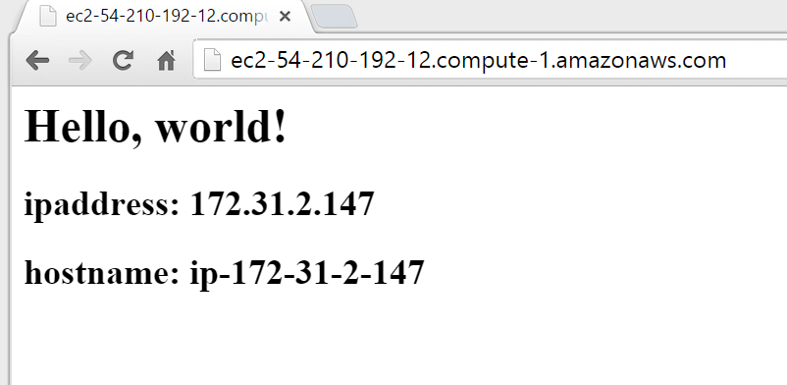
GE: Testing your Websites
URL of proxy server.
Output from the web server.
Notes:
Point a web browser to the URL or IP address of your proxy server. It should display the web page of the web server node that the proxy server is configured to serve.

Slide 43
Proxy Server
Adding a proxy will allow us to better grow our infrastructure.
Find or Create a Cookbook to Manage a Proxy Server
Configure the Proxy Server to send traffic to the new node
Upload cookbook to Chef Server
Bootstrap a new node that runs the Proxy Server cookbook
Notes:
With your node running the myhaproxy's cookbook's default recipe--relaying traffic to your first node running the apache cookbook's default recipe--you have moved closer to creating the original topology we set out to define today.

Slide 44
Discussion
What questions can we help you answer?

